Slide 1
IPv6 ACLs
John Rullan Cisco Certified Instructor Trainer Thomas A. Edison CTE HS Stephen Lynch
Network Architect, CCIE #36243
ABS Technology Architects

Slide 2
IPv6 ACL Operation
IPv6 ACLs are very similar to IPv4 ACLs in both operation and configuration. Being familiar with IPv4 access lists makes IPv6 ACLs easy to understand and configure.
IPv6 has only one type of ACL, which is equivalent to an IPv4 extended named ACL.
There are no numbered ACLs in IPv6, only named ACL.
IPv4 uses the command ip access-group to apply an IPv4 ACL to an IPv4 interface. IPv6 uses the ipv6 traffic-filter command to perform the same function for IPv6 ACLs.
IPv6 ACLs do not use wildcard masks. Instead, the prefix-length is used to indicate how much of an IPv6 source or destination address should be matched.

Slide 3

IPv6 ACL Topology
2001:DB8:CAFE::2/127
Internet
R2
S0/0/1
S0/0/0
2001:DB8:CC1E::/127
2001:DB8:CC1E:A::/64
S0/0/0
R1
ISP_ASW
2001:DB8:CC1E:1::/64
2001:DB8:CC1E:2::/64
S1
S2
Outside Host
2001:DB8:CC1E:A::1/64
Admin
Host
DNS Server
Web Server
www.cisco.pka
2001:DB8:CC1E:A::2/64
2001:DB8:CC1E:1::1/64
2001:DB8:CC1E:2::1/64
2001:DB8:CC1E:A::2/64

Slide 4
Restrict Access to VTY Lines
In this example, we will only allow the Admin PC to telnet into R1 while denying all others.
Use the ipv6 access-list command to create a named IPv6 ACL. Like IPv4 named ACLs, IPv6 names are alphanumeric, case sensitive and must be unique.
Use the permit or deny statements to specify one or more conditions to determine if a packet is forwarded or dropped.
Use the ipv6 access-class command to apply the ACL to the VTY lines.
2001:DB8:CC1E:1::/64
2001:DB8:CC1E:2::/64
S1
R1
S2
Admin
Host
2001:DB8:CC1E:1::1/64
2001:DB8:CC1E:2::1/64

Slide 5
ACL Configuration Example
The permit statement only allows the Admin PC to telnet into R1.
The implicit deny statement (not configured) will deny all others from establishing a telnet session into R1.
Apply the ACL to the VTY lines, using the ipv6 access-class command and with in as the direction.
R1(config)#ipv6 access-list NO_TELNET
R1(config-ipv6-acl)#permit tcp host 2001:db8:cc1e:1::1 any eq 23
R1(config-ipv6-acl)#exit
R1(config)#line vty 0 15
R1(config-line)#ipv6 access-class NO_TELNET in
R1(config-line)#exit
R1(config)#

Slide 6
ACL Configuration Example (Cont’d)
The show access-lists command displays all configured IPv4 and IPv6 ACLs configured on the router.
The show ipv6 access-list command will display all configured IPv6 access lists specified by name. (No numbered IPv6 ACLs)
R1#show ipv6 access-list
IPv6 access list NO_TELNET
permit tcp host 2001:DB8:CC1E:1::1 any eq telnet
2001:DB8:CC1E:1::/64
2001:DB8:CC1E:2::/64
S1
R1
S2
Admin
Host
2001:DB8:CC1E:1::1/64
2001:DB8:CC1E:2::1/64

Slide 7
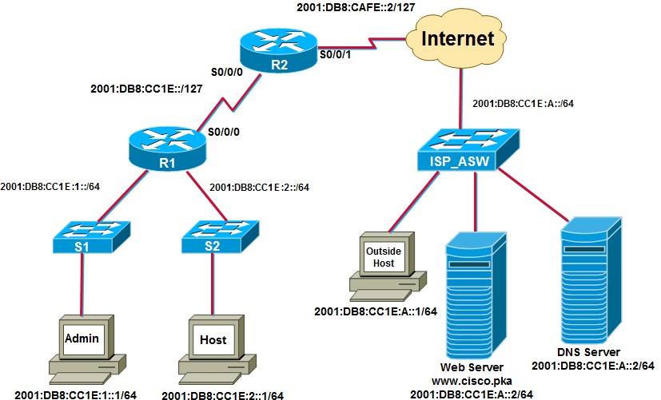
Restrict Web Server Access
Configure an extended ACL to block TCP applications HTTP & FTP traffic sourcing from the Admin PC and Host PC specific IPv6 address when destined for the Internet LAN. Permit all other types of traffic.
R1(config)#ipv6 access-list DENY_WWW_FTP
R1(config-ipv6-acl)#remark Deny WWW and FTP access from R1 LANs to Web Server
R1(config-ipv6-acl)#deny tcp 2001:db8:cc1e:1::/64 2001:db8:cc1e:a::/64 eq www
R1(config-ipv6-acl)#deny tcp 2001:db8:cc1e:1::/64 2001:db8:cc1e:a::/64 eq ftp
R1(config-ipv6-acl)#deny tcp 2001:db8:cc1e:2::/64 2001:db8:cc1e:a::/64 eq www
R1(config-ipv6-acl)#deny tcp 2001:db8:cc1e:2::/64 2001:db8:cc1e:a::/64 eq ftp
R1(config-ipv6-acl)#permit ipv6 any any
R1(config-ipv6-acl)#exit
R1(config)# int s0/0/0
R1(config-if)# ipv6 traffic-filter DENY_WWW_FTP out

Slide 8
IPv6 ACL Verification Commands
R1#show ipv6 access-list DENY_WWW_FTP
IPv6 access list DENY_WWW_FTP
deny tcp 2001:DB8:CC1E:1::/64 2001:DB8:CC1E:A::/64 eq www
(28 match(es))
deny tcp 2001:DB8:CC1E:1::/64 2001:DB8:CC1E:A::/64 eq ftp
deny tcp 2001:DB8:CC1E:2::/64 2001:DB8:CC1E:A::/64 eq ftp
deny tcp 2001:DB8:CC1E:2::/64 2001:DB8:CC1E:A::/64 eq www
permit ipv6 any any (3 match(es))
The ACL matched 28 denies based on the ACL statement.
The deny and permit command is used to specify one or more conditions to determine if a packet is forwarded or dropped.

Slide 9
Editing IPv6 ACLs
In order to edit an IPv6 ACL, you can insert an ACL statement based on the sequence number. By default, sequence numbers are in increments of 10.
R1#show access-lists
IPv6 access list NO_TELNET
permit tcp host 2001:DB8:CC1E:1::1 any eq telnet (2 matches) sequence 10
IPv6 access list DENY_WWW_FTP
deny tcp 2001:DB8:CC1E:1::/64 2001:DB8:CC1E:A::/64 eq www sequence 20
deny tcp 2001:DB8:CC1E:1::/64 2001:DB8:CC1E:A::/64 eq ftp sequence 30
deny tcp 2001:DB8:CC1E:2::/64 2001:DB8:CC1E:A::/64 eq www sequence 40
deny tcp 2001:DB8:CC1E:2::/64 2001:DB8:CC1E:A::/64 eq ftp sequence 50
permit ipv6 any any sequence 60
R1(config)#ipv6 access-list DENY_WWW_FTP R1(config-ipv6-acl)#permit tcp host 2001:db8:cc1e:1::12 host 2001:db8:cc1e:a:: eq www sequence 25
R1(config-ipv6-acl)#permit tcp host 2001:db8:cc1e:1::12 host 2001:db8:cc1e:a:: eq ftp sequence 25
R1#show ipv6 access-list IPv6 access list NO_TELNET permit tcp host 2001:DB8:CC1E:1::1 any eq telnet (2 matches) sequence 10 IPv6 access list DENY_WWW_FTP deny tcp 2001:DB8:CC1E:1::/64 2001:DB8:CC1E:A::/64 eq www sequence 20
permit tcp host 2001:DB8:CC1E:1::12 host 2001:DB8:CC1E:A:: eq www sequence 25
permit tcp host 2001:DB8:CC1E:1::12 host 2001:DB8:CC1E:A:: eq ftp sequence 25 deny tcp 2001:DB8:CC1E:1::/64 2001:DB8:CC1E:A::/64 eq ftp sequence 30 deny tcp 2001:DB8:CC1E:2::/64 2001:DB8:CC1E:A::/64 eq ftp sequence 40 deny tcp 2001:DB8:CC1E:2::/64 2001:DB8:CC1E:A::/64 eq www sequence 50 permit ipv6 any any sequence 60
Notes:
You can delete a statement without having to delete the entire ACL. You can also add a statement in the exact placement based on the sequence number. If you notice, we added two ACLs statements between 20 and 30 using sequence number 25. If I needed to add an additional ACL statements, I can do so using sequence number 26 or 24 depending on what you’re trying to do.

